Slide 1
An Analytic Solution for Predicting Hospital Readmissions
Christopher Klocke
Jacob Gutierrez
Frank Longano

Slide 2
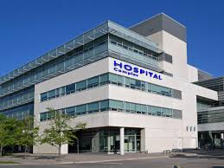
Introduction
Integrated non-profit healthcare delivery system with 8 hospitals, over 100 locations including ambulatory clinics, and employing over 1000 health care providers.
Over 40,000 hospital discharges per year
Hospital executive leadership requested a pilot project for an analytic solution to decrease 30 day hospital readmissions
We are here today to discuss the results this predictive modeling project

Slide 3
Hospital Readmissions
Why do we need to prevent 30 day readmissions?
Care quality and Patient experience: associated with poor outcomes and quality related events, including adverse events related to medication errors, care transition failures, and absent or delayed followed up.
Cost: $40 billion per year total, $17 billion dollars/year in avoidable Medicare expenditures.
Average cost of readmission higher than index admission
CMS Readmission Reduction Program, 3% penalty on reimbursement if readmission rate higher than expected. In 2017: average $225,000/hospital.

Slide 4
Alternative to predictive modeling of readmissions
Current 30 day readmission rate higher than average (13.9%)
Current discharge risk stratification based on physician intuition
Continued Medicare reimbursement penalties. Potential penalties of $1.5 million dollars per year.
Impede organizational shift to value based care:
Under new accountable care model we will face increasing financial risk for uncoordinated care, such as emergency department and hospital utilization
Difficult to quantify financial risk
Strategic organizational goal to increase to 50% of care delivery to value based payment models by 2025
Poor patient experience = potential loss of market share to competing system

Slide 5
Analysis Plan
Considerations
Dataset has limited predictors but many data points
Comorbidities modeled were cerebrovascular disease and congestive heart failure
Conduct 2 approaches and measure metrics
Simple Logistic Regression
Complex Support Vector Machine

Slide 6
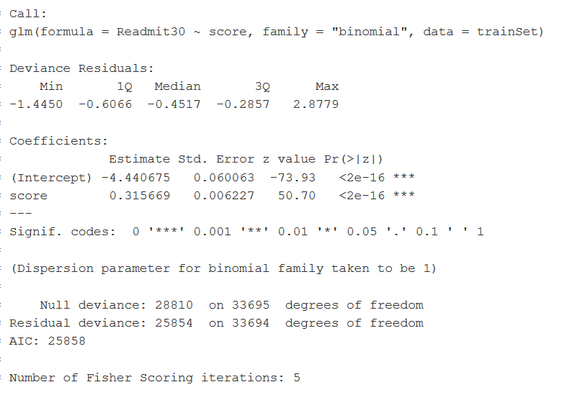
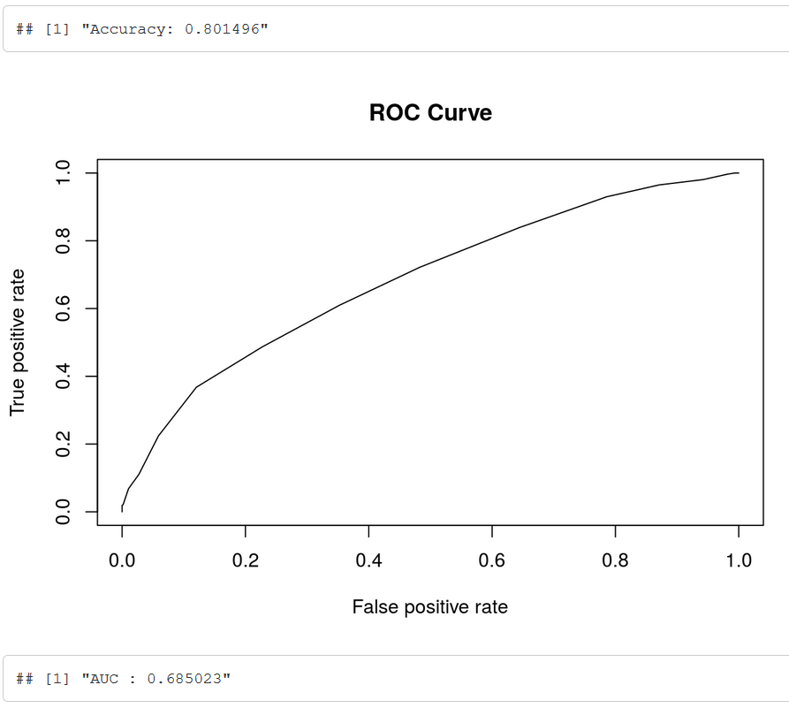
Logistic Regression Model 1 : composite score

Slide 7
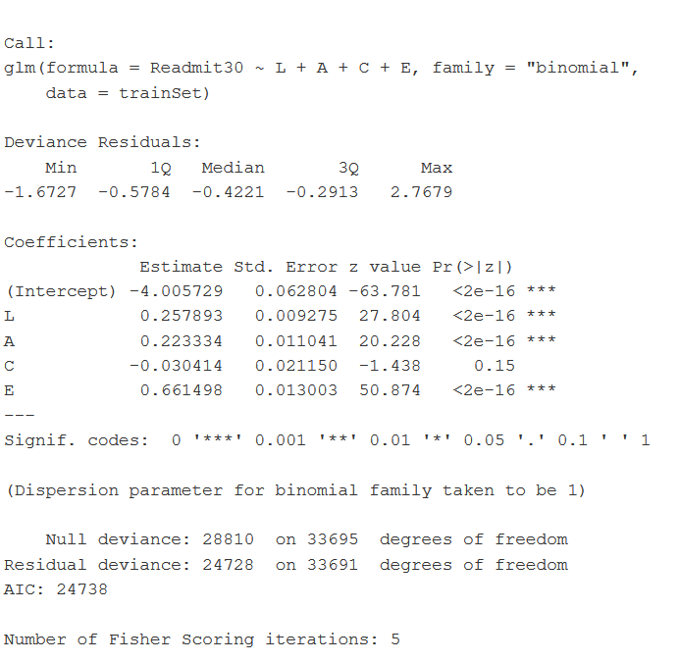
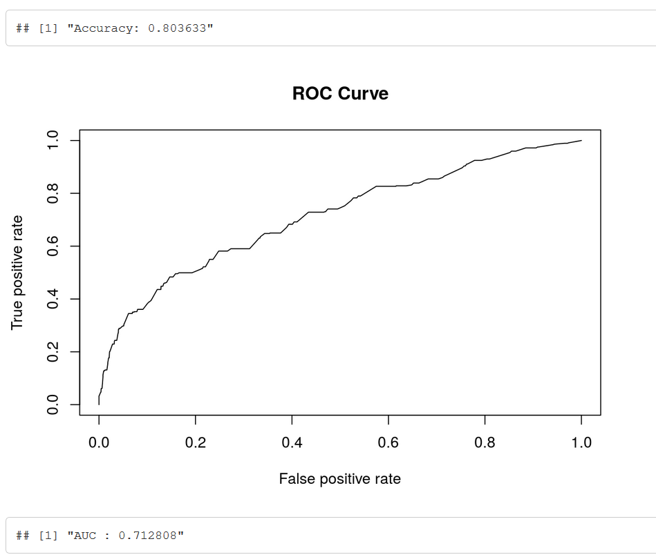
Logistic Regression Model 2: individual LACE

Slide 8
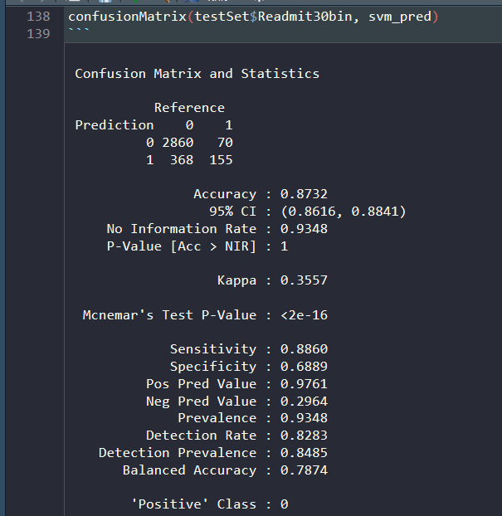
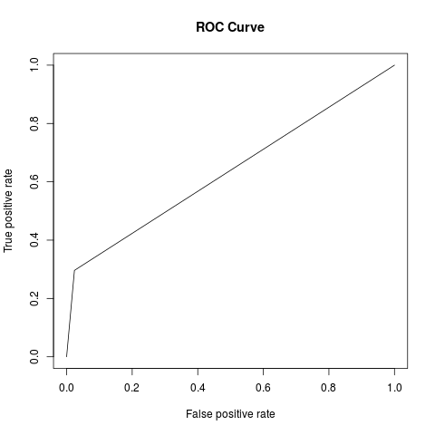
Support Vector Machine: individual LACE

Slide 9
Intervention and Implementation
Prediction result will be deployed in the clinical workflow via EHR
Alert will fire to discharging physician triggered by various orders that may signal the start of the discharge process
Patients predicted as high risk for readmission will have interventions:
Pharmacist medicine reconciliation and pre-discharge medication management consultation in cases of high risk polypharmacy
Care management nursing follow up phone call in 48 hours
Care management nurse home visit in 72 hours
Primary care practitioner office follow up in 5 days
Quality improvement project/monitoring: Cluster randomization – try at 3 sites, compare outcomes over 6 months to other 5 sites without. Outcome measures will include 30 day readmission rate, post discharge mortality rate, and a balance measure to monitor the impact on care management nursing workload.

Slide 10
Needs and Follow up
Executive leadership to support a funding request to the budget office
In order to scale and deploy this solution to 3 hospitals we request funding for 1.0 FTE care management RN and 1.0 FTE data analyst per implementing hospital
Clinical leadership to begin discussions with medical, nursing and pharmacists at the local level about the solution, deployment process, and training.
Plan for rollout at 3 hospitals in 3 months

